Slide 1
Data-intensive computing
Inf-2202 Concurrent and Data-intensive Programming
University of Tromsø, Fall 2016
Lars Ailo Bongo (larsab@cs.uit.no)

Slide 2
Outline
Today:
Introduction to data-intensive computing
Data-intensive computing platforms
Google File System, MapReduce
My research
3/11: Spark ecosystem
GraphX, Mllib, Spark-R,…
4/11: Guest lecture about Stallo Supercomputer?
10/11: Guest lecture?
11/11: Summary lecture
24/11: Exam

Slide 3
Data-intensive Computing
Big data
+ Machine learning/ statistics
FYS-3012 Pattern recognition
(Linear algebra & statistics)
+ Distributed systems
INF-3200, INF-3203, INF-3201, and more
(= Data analytics)

Slide 4
Big Data Sources
Human produced content
Videos, photos, audio…
Human activity
Online activity, GPS traces, tax records…
Scientific instruments
CERN LHC, Sloan Digital Sky Survey, DNA sequencers…
Sensor data
Cars, smart devices, medical instruments, …

Slide 5
Big data players
Industry:
Google, Facebook, Twitter, Amazon, Netflix, Visa, …
Use data to provide services
Use data to make money
Has developed (most of the) technology for managing and processing peta-scale datasets
Government:
NSA, Skatteetaten, Kartverket, e-resept, …
Use data to make (hopefully) informed decisions
Make data available for public and commercial services
Science
Biology, physics, medicine, social sciences,…
Use data for novel scientific insights
Should be open access, indexed, reusable, …

Slide 6
Big Data
How big?

Slide 7
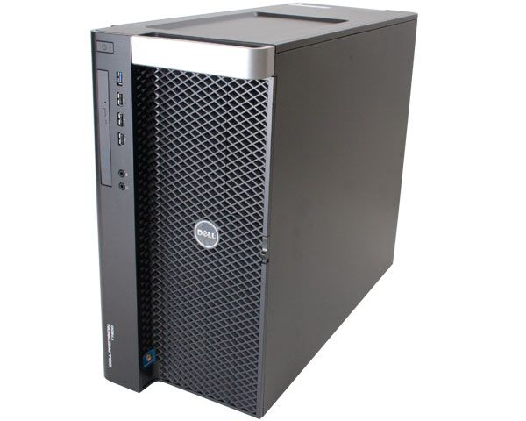
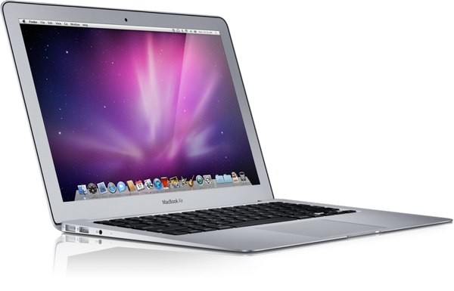
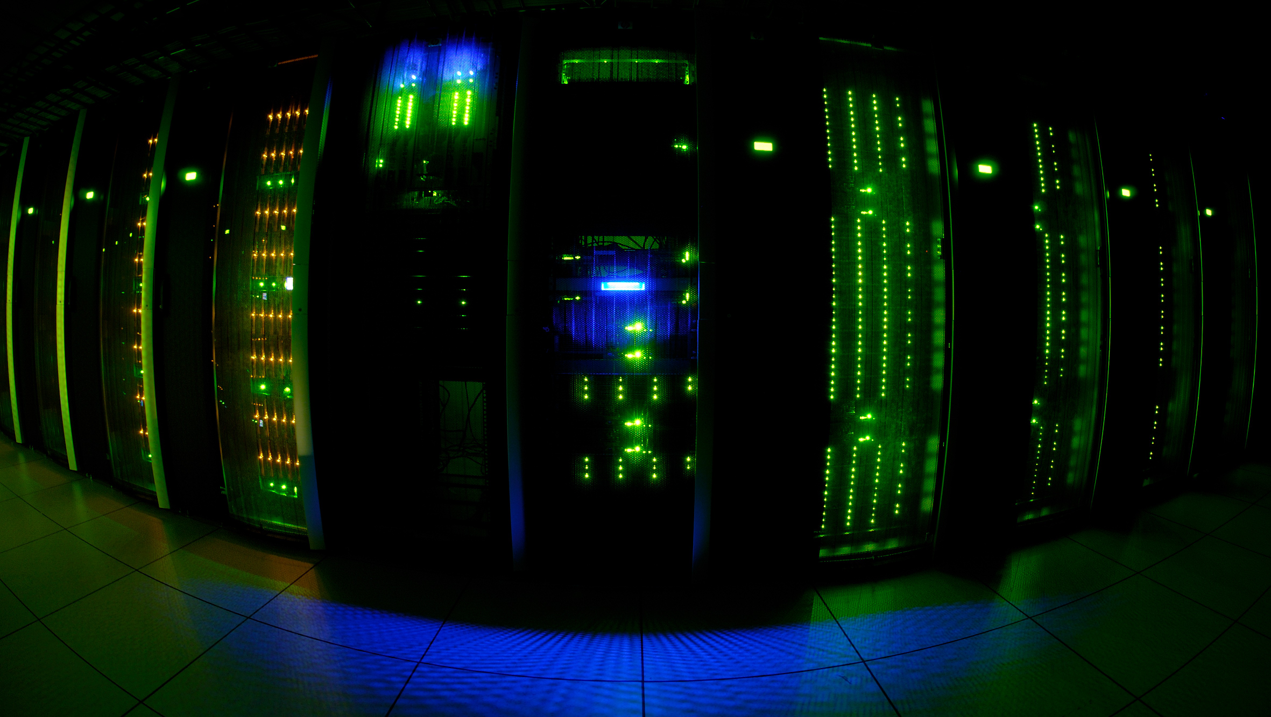
Dataset Size
< 4GB
< 512GB
TBs
PBs

Slide 8
Statistical Analysis (N x M)
Billions of samples & few dimensions, or
Billions of samples & thousands of dimensions, or
Thousands of samples & thousands of dimensions

Slide 9




Data Analysis Tool

Slide 10
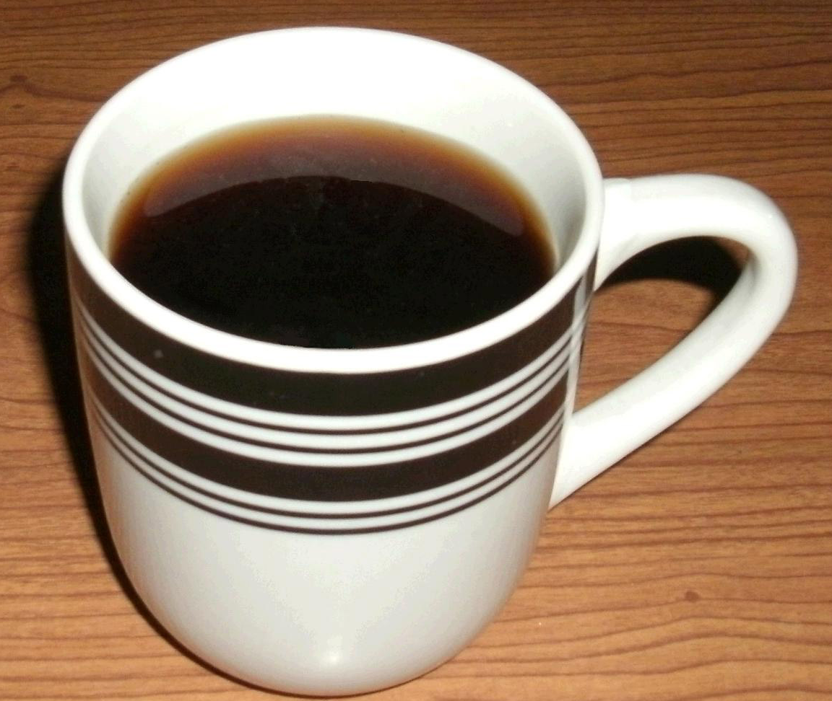
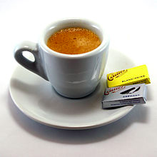
Computation Time
<100ms
seconds
minutes
hours
weeks

Slide 11
Optimizations
R or Matlab implementation
Algorithm parameter tuning
C++/ Java / … implementation
Data structure optimization
Multi-threaded parallelization (single machine)
Distributed parallelization (multiple-machines)

Slide 12
Outline
History of Big Data + Biology
My research
Google File System
MapReduce

Slide 13
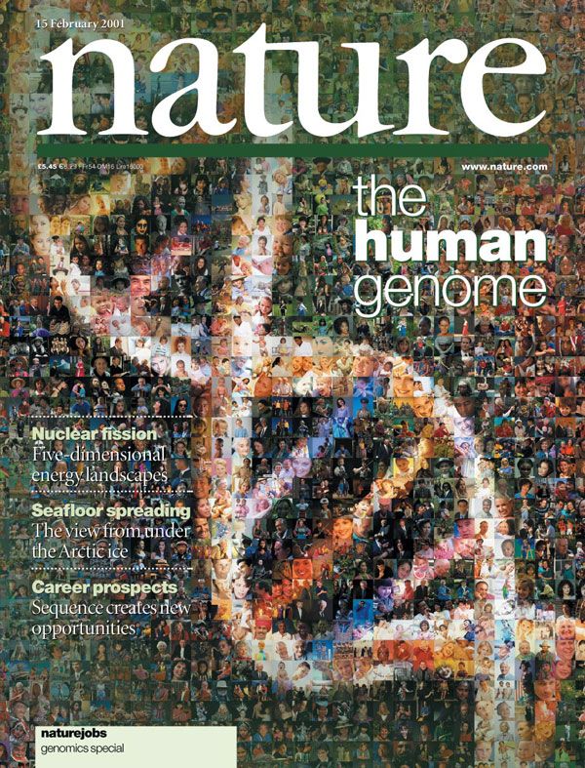
Notes:
2001

Slide 14
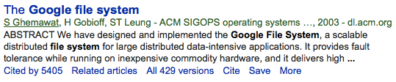
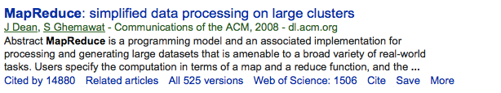
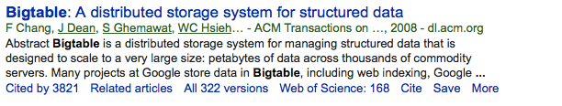
Notes:
Google founded: 1998
GFS: 2003
M/R: 2004
BigTable: 2006
Hadoop: 2005ish

Slide 15
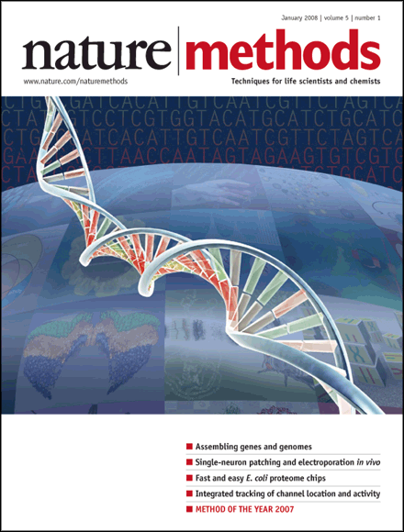
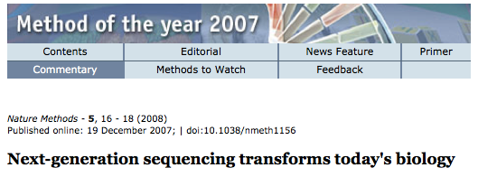
Notes:
2008

Slide 16
Notes:
Published in 2009
Jim Gray’s talk 2007
Empirical
Theoretical
Computational
Data exploration

Slide 17
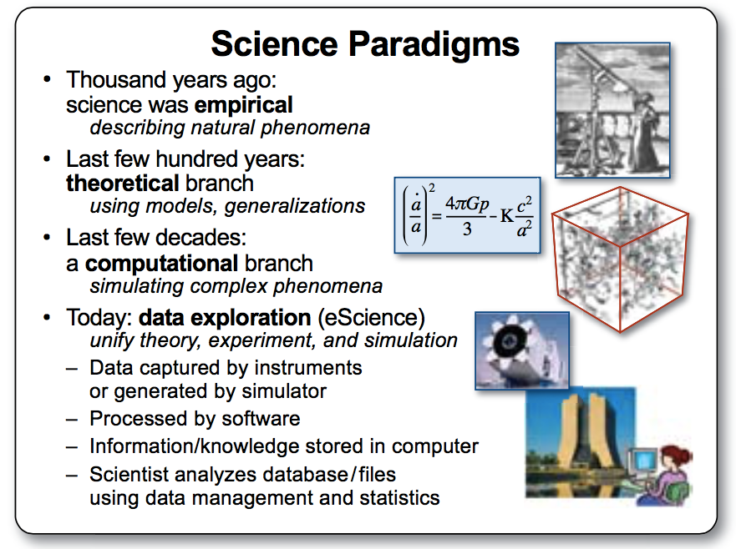
Jim Grays Talk

Slide 18
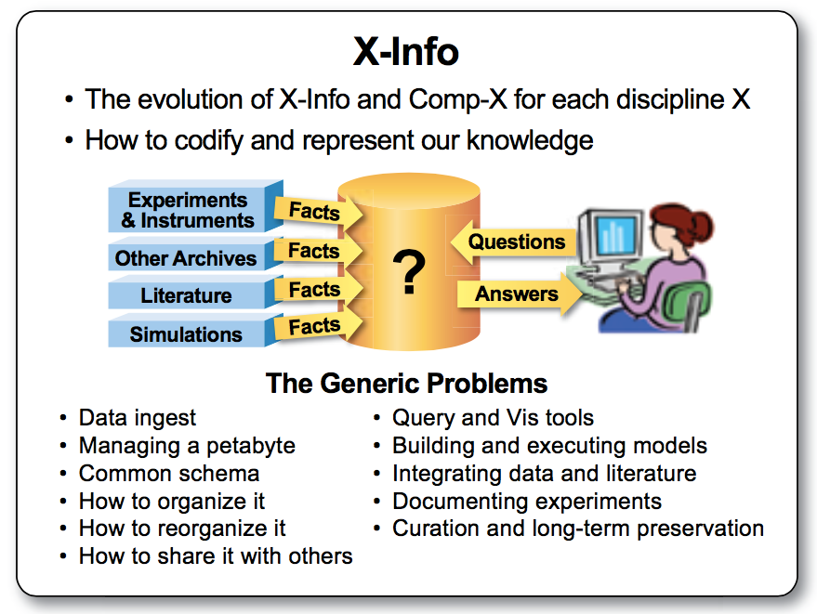

Slide 19
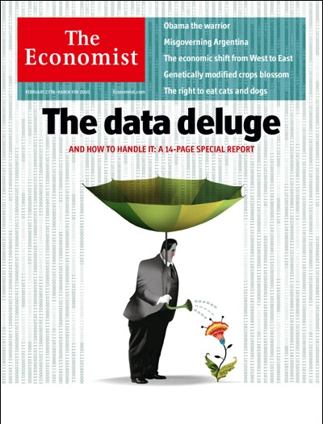
Notes:
2010

Slide 20
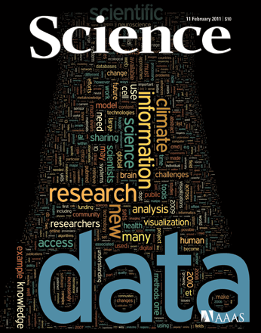
Notes:
2011

Slide 21
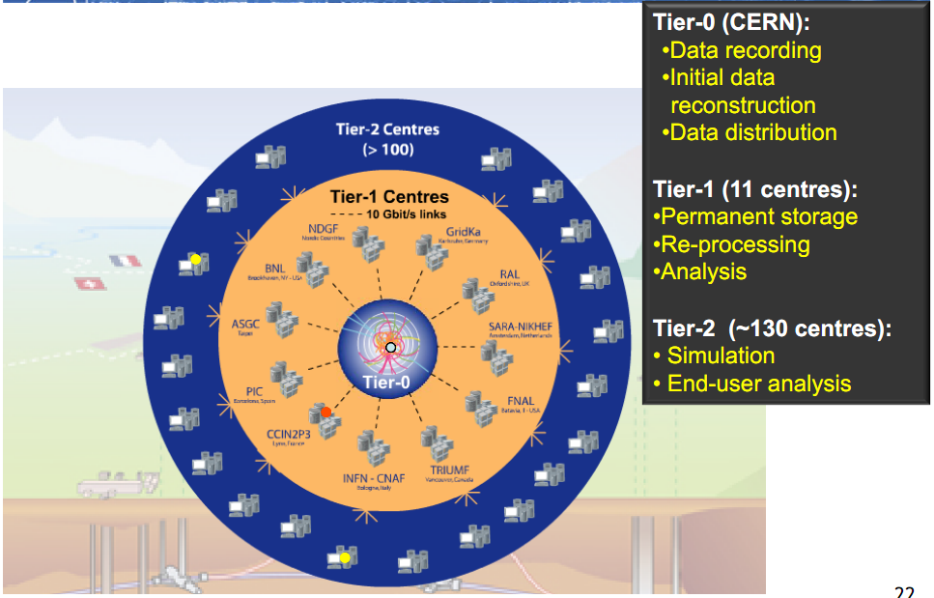
Scientific Storage Systems
Source: http://www.usenix.org/events/lisa10/tech/slides/cass.pdf

Slide 22
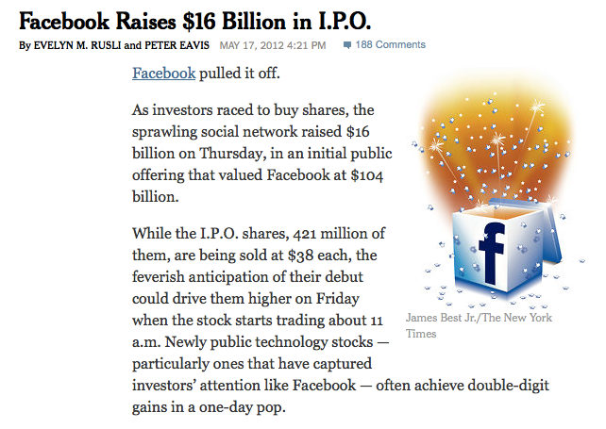
Notes:
2012

Slide 23
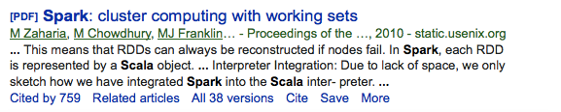
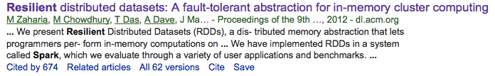
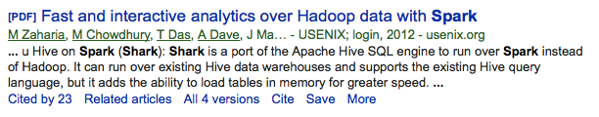
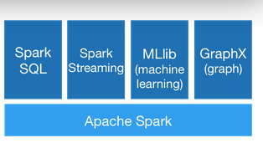
Notes:
Spark: 2010/ 2012

Slide 24
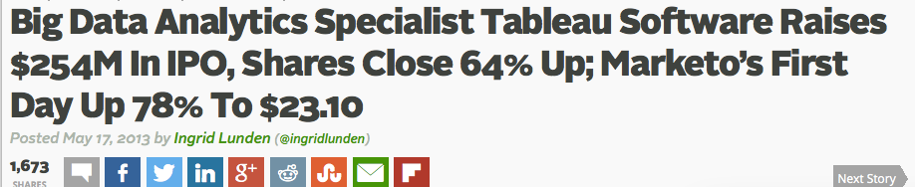
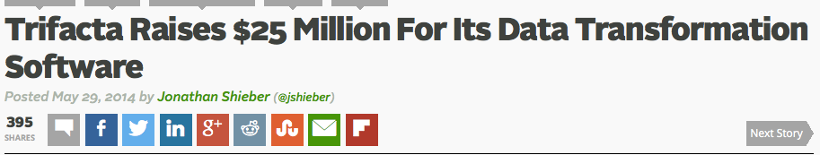
Notes:
Tableu IP: 2013
Trifacta startup: 2014

Slide 25
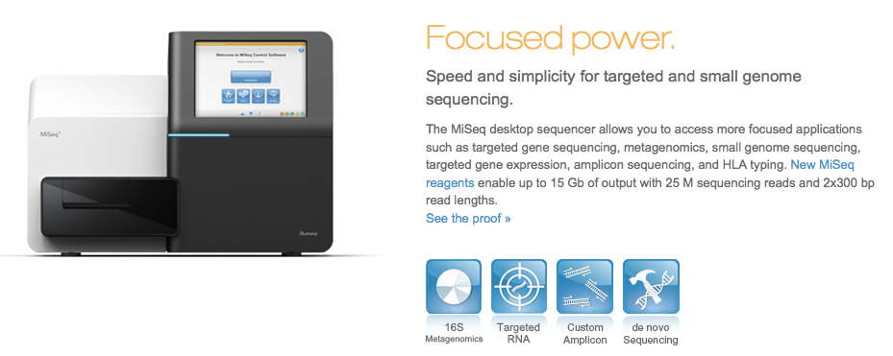
Notes:
2011: launched
UiT got one in 2013?

Slide 26
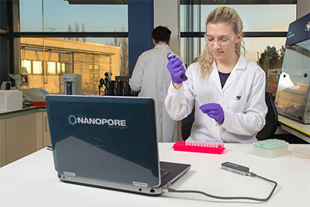
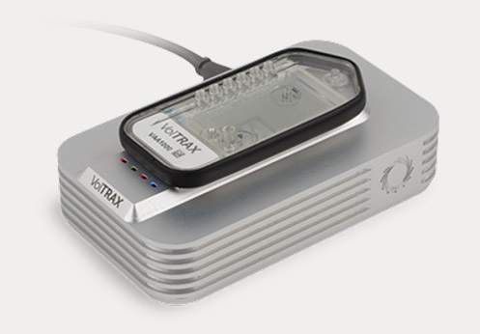
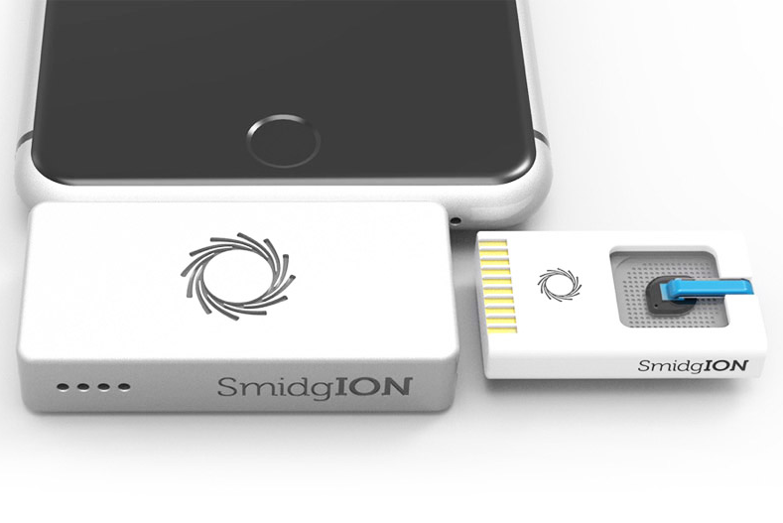
Notes:
Oxford nanopores: MinION

Slide 27
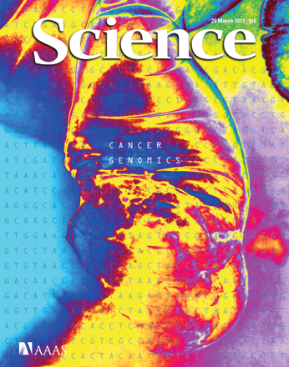
Notes:
2013: Special issue on cancer genomics

Slide 28
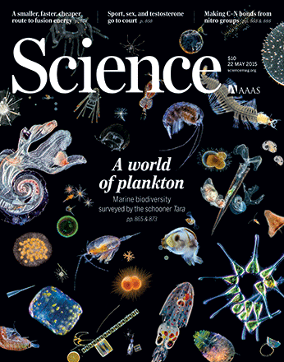
Notes:
2015: marine metagenomics

Slide 29
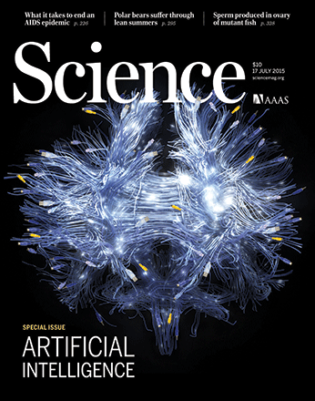
Notes:
2015: AI

Slide 30
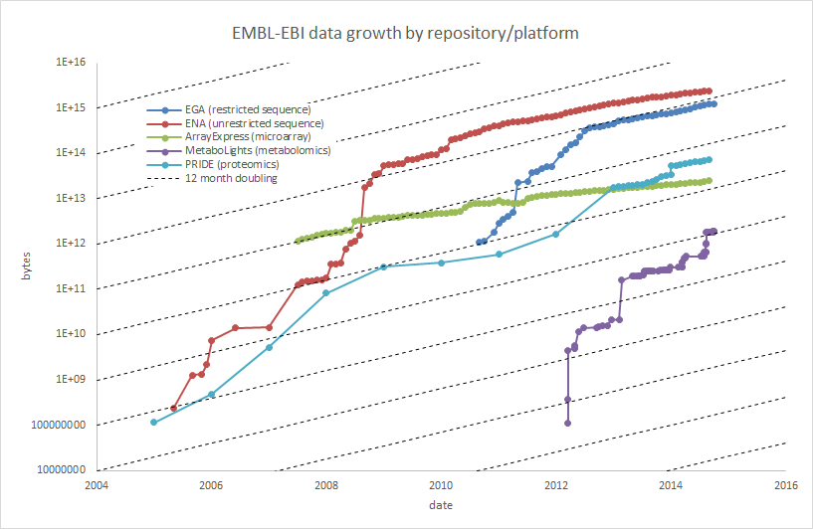
Data growth in the life sciences
PB
Notes:
Phenomenal data growth – dotted lines represents doubling every twelve months

Slide 31
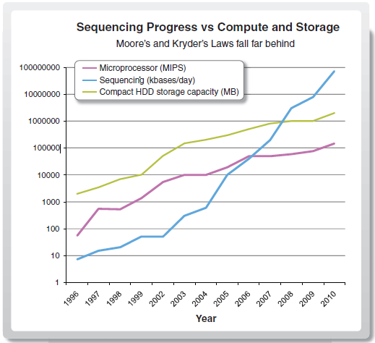
Increase in bionformaticians?
@UiT
Notes:
My old motivation slide

Slide 32
BDPS

Slide 33
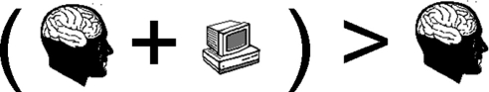
Research Goal

Slide 34
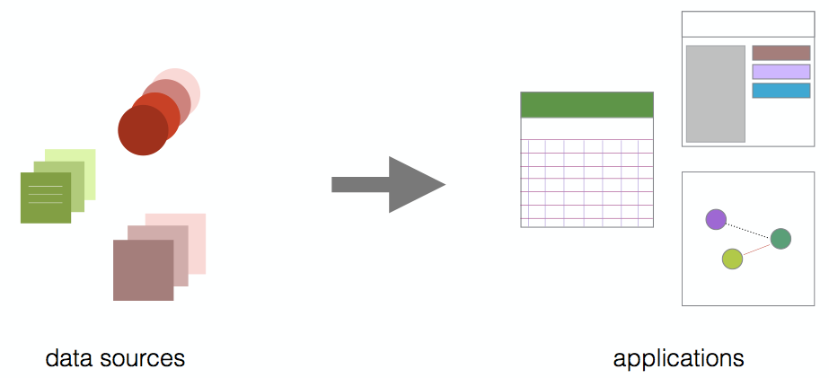
EXCELLENCE: Norwegian Woman and Cancer (NOWAC)
Large and unique biobank of blood samples
Understand development of cancer (and how to avoid it)
Develop diagnosis approaches
Develop or improve treatment
http://site.uit.no/nowac/

Slide 35
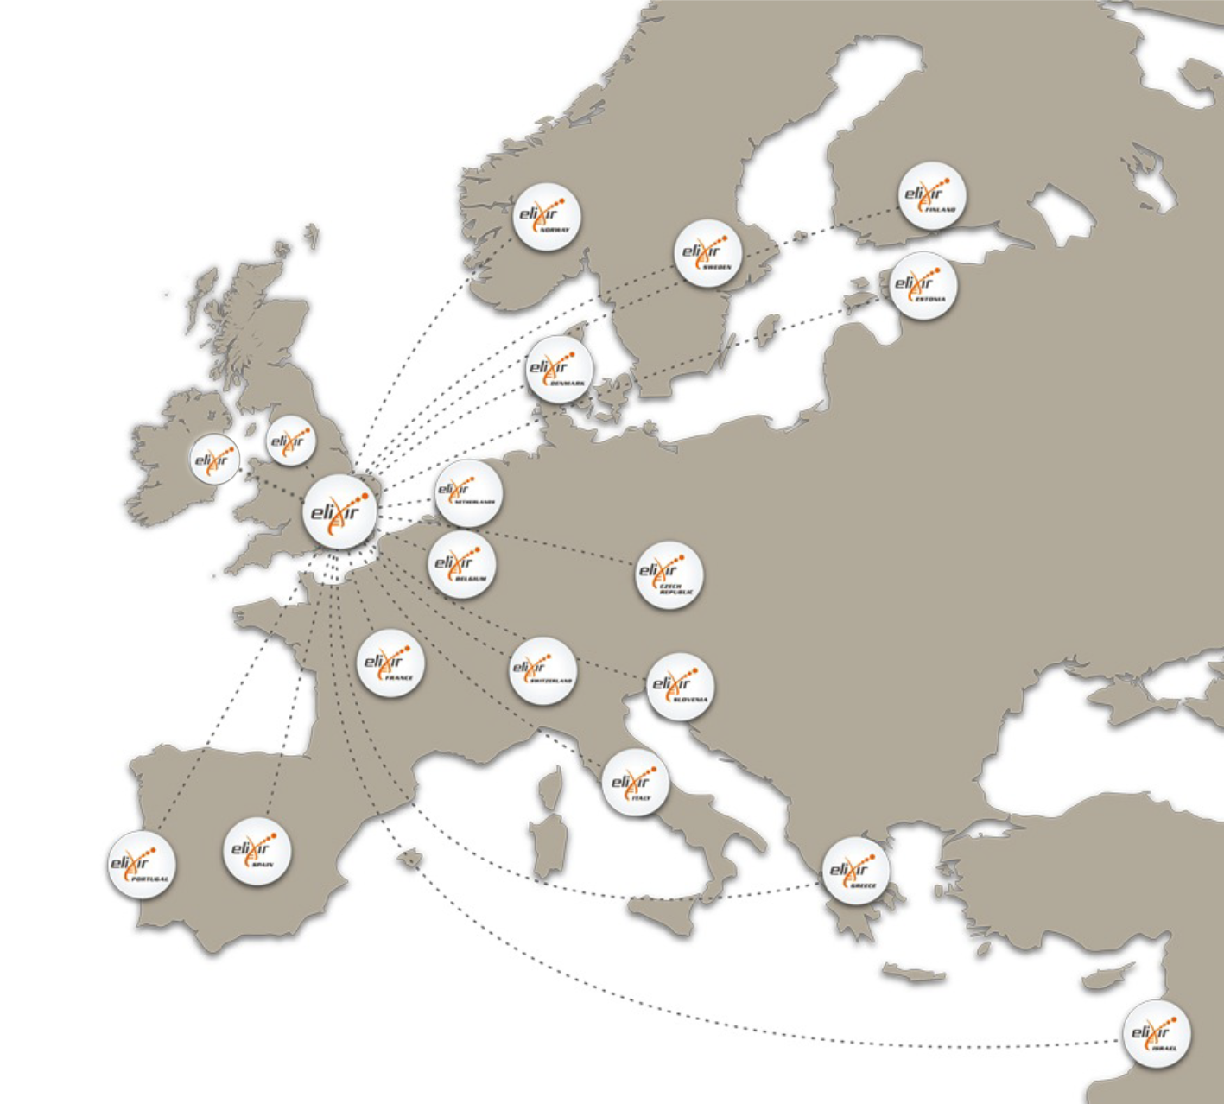







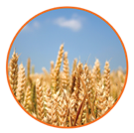
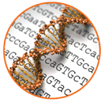

IMPACT: ELIXIR: An international distributed infrastructure for biological data
Technical platforms
Data
Standards
Tools
Compute
Training
User communities
Marine metagenomics
Crop and forest plants
Human data
Rare diseases

Slide 36
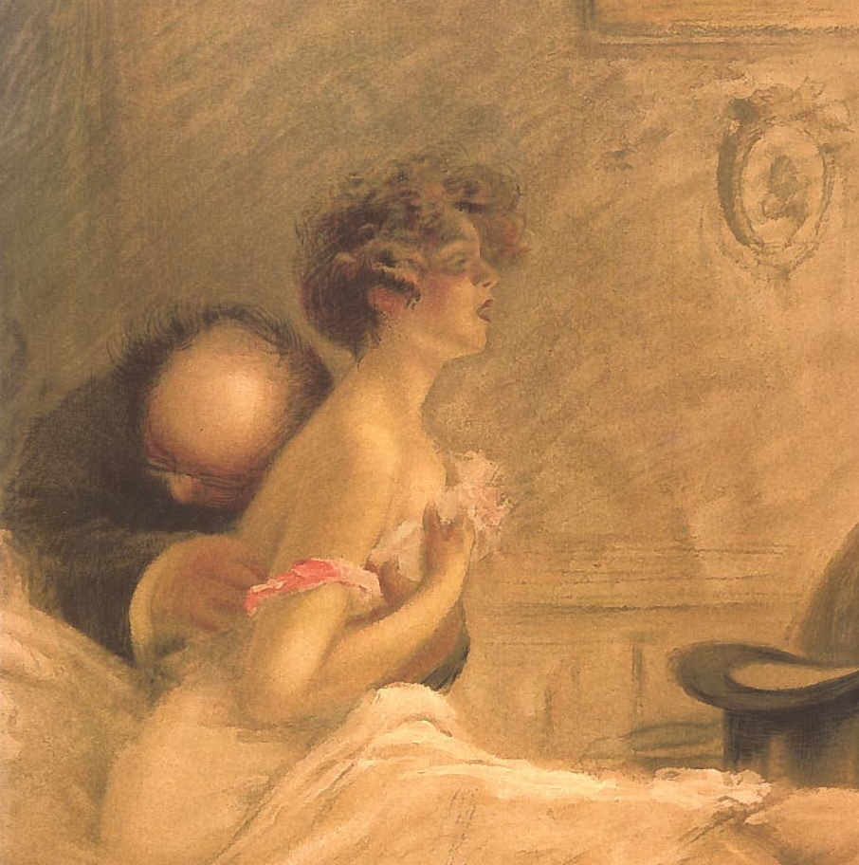
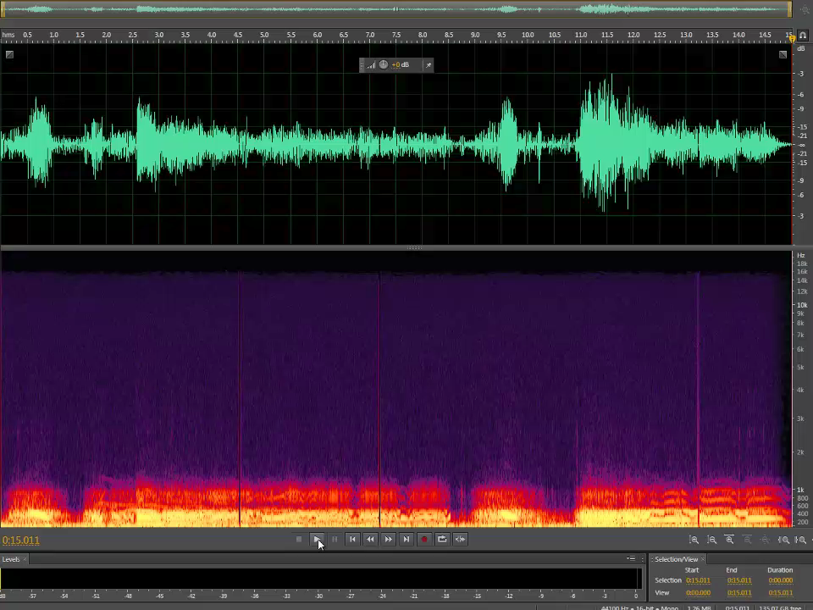
INNOVATION: Lung sounds
1000s of recordings (Tromsøundersøkelsen)
Machine learning based classification
Commercialization

Slide 37
IMPLEMENTATION: The Team
NOWAC
Einar Holsbø (PhD student)
Bjørn Fjukstad (PhD student)
Morten Grønnesby, (PhD student)
Other projects
Johan Ravn (master student, lung sounds)
Frode Opdahl (master student, virtual reality)
Nina Angelvik (master student, air pollution)
Center for Bioinformatics (SfB)
Edvard Pedersen (PhD student)
Espen Robertsen (PhD student)
Inge Alexander Raknes (engineer)
Giacomo Tartari (engineer)
Aleksandr Agafonov (engineer)
Jon Ivar Kristiansen (system administrator)

Slide 38
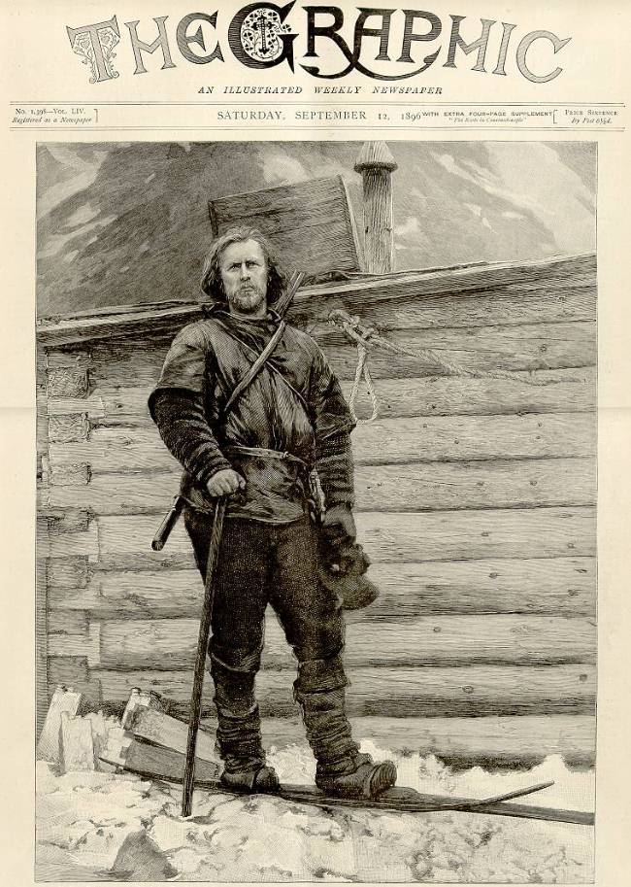
Interactive Data Exploration

Slide 39
Interactive Data Exploration Components
Human experts for data analysis
Interactive user interface
Analysis methods and models
Data management and backend processing
Compute and storage resources

Slide 40
Data-intensive computing platforms

Slide 41
Outline (part 2)
Hardware platforms
Infrastructure systems
Google File System
MapReduce
Ecosystems

Slide 42
Hardware Requirements
Process 1TB of data?
Process 1PB of data?

Slide 43
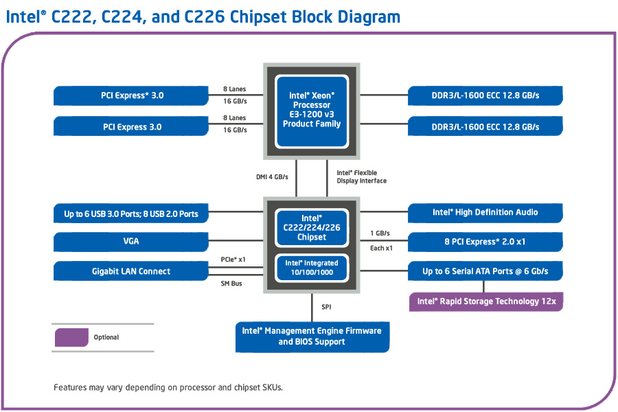
Single Computer
Notes:
Source: http://www.intel.com/content/dam/www/public/us/en/images/diagrams/c222-c224-c226-chipset-diagram-3x2.jpg
1TB
SAS-2: 6Gbit/s => 23 minutes to read
SAS-3: 12Gbit/s
1PB: 16 days if 6Gbit/s

Slide 44
Supercomputer
…
Infiniband 56Gbits/s 164Gbit/s
…
Disadvantages:
Centralized storage has limited bandwidth
High cost of interconnect
Notes:
1TB
56Gbit/s => 146s
164Gbit/s => 49s
1PB
54 => 42h
164 => 14h

Slide 45
Commodity Component Distributed System
SATA 6Gbit/s
…
…
Notes:
1TB
on 100 nodes => 14s
On 1000 nodes => 1.4s
1PB
on 100 nodes => 4h
On 1000 nodes => 23min

Slide 46
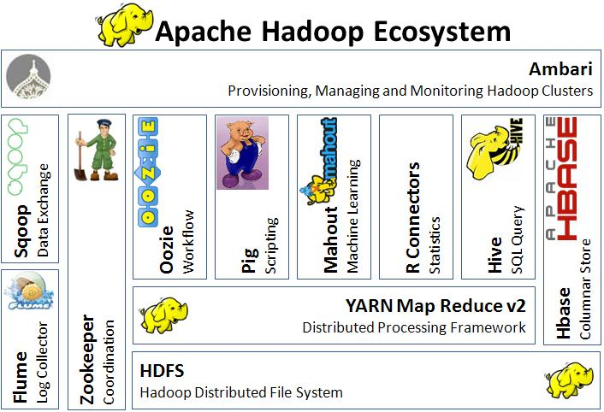
Hadoop

Slide 47
Google File System (GFS)
https://courses.cs.washington.edu/courses/cse490h/11wi/CSE490H_files/gfs.pdf
Hadoop Distributed File System implements GFS design

Slide 48
MapReduce
http://research.google.com/archive/mapreduce-osdi04-slides/index.html
Hadoop MapReduce implements Google MapReducedesign

Slide 49
BigTable
Hbase implements BigTable design

Slide 50
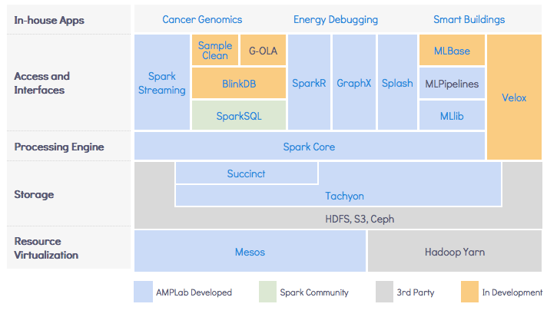
Spark Ecosystem
Notes:
https://amplab.cs.berkeley.edu/software/

